Slide 1

SHAY.AI
AI that Connects You in IRL!!!

Slide 2
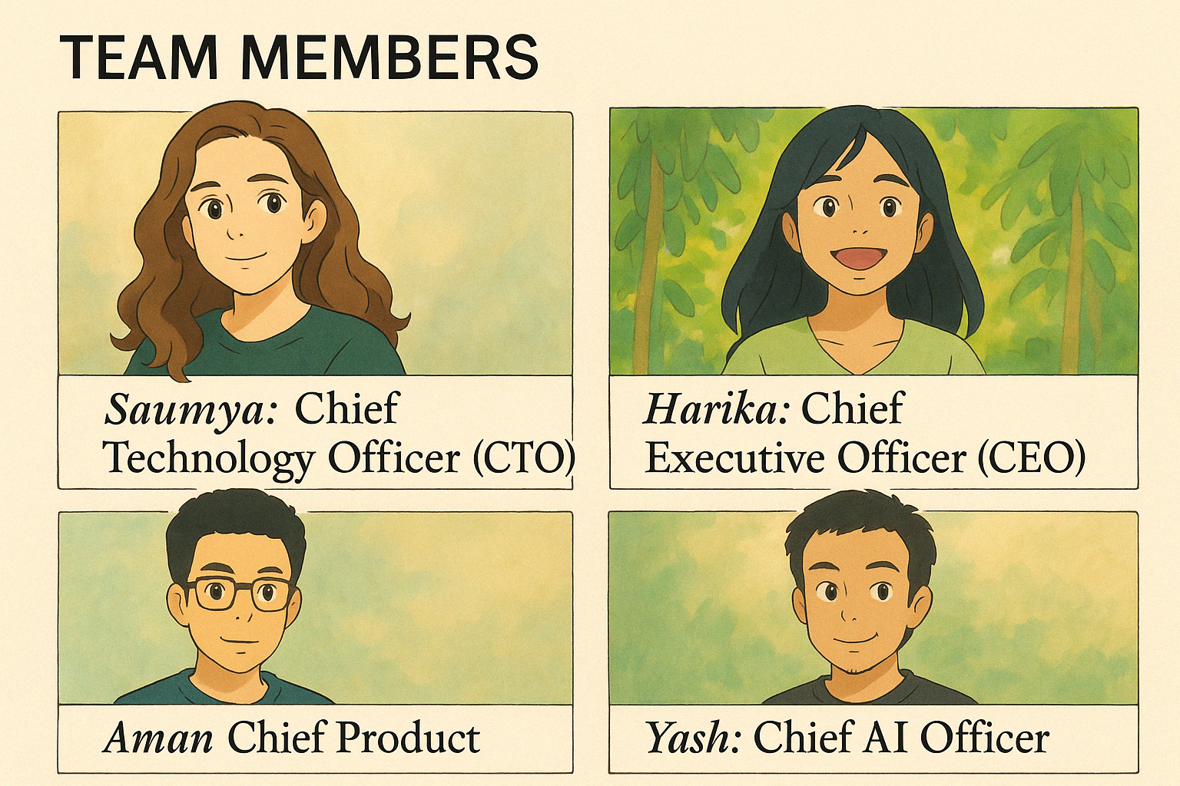

Slide 3

SHAY.AI
One stop shop for every type of event!
Helps you shortlist people based on your goals
Generates messages and reaches out them for you!
Notes:
Shay.ai is your smart networking assistant that helps you discover and connect with the most relevant people at any event. Whether you're looking for a job, a co-founder, or just someone interesting to meet, you simply tell the bot—and it shows you curated profiles pulled from Luma, Meetup, and LinkedIn. You can swipe through suggestions, ask for more details, and even get help crafting personalized reach-outs. With NLP-powered insights and a clean, modern UI, EventMatch AI makes your event experience focused, efficient, and way more impactful.

Slide 4


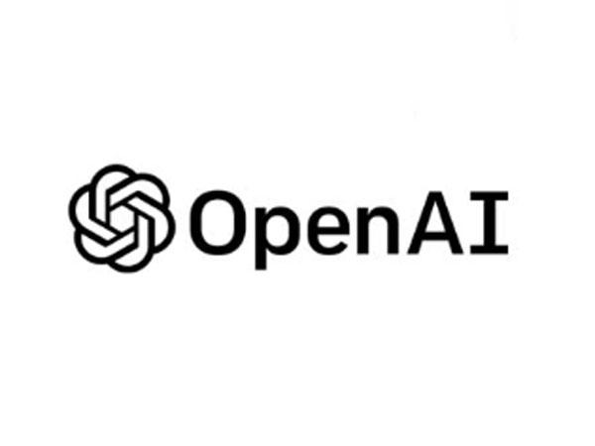

TECH STACK
React.js
Typescript
Open AI
Supabase

Slide 5

Market
Community Builders, Event Organizers
Startup Founders
Universities

Slide 6
MARKET SEGMENTS
Market Segment | Description | Size (2024–2025 Estimates)
Professional Events & Conferences | Includes tech summits, startup expos, product meetups | $30B+ global market, 10M+ annual attendees (U.S.)
University Career Services & Alumni Networks | Events organized by CMU, Stanford, etc. | ~20M active alumni + 4M college grads/year in U.S.
Online Communities & Creator Events | Events via Luma, Circle, Discord, Twitter Spaces | 50M+ creators, 1.5B community members globally
Startup Ecosystem | Founders, angels, accelerators like YC or Techstars | 1M+ early-stage startups, 30K+ events/year
Hybrid/Dating & Social Mixers | Interest-based events, IRL meetups, and casual networking | Growing trend post-pandemic; apps/events see 50–100M+ users globally

